Slide 1
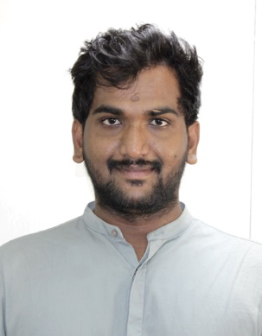
PUNUGOTI NAGARJUNA REDDY – CONSULTANT - ANSIBLE AUTOMATION CONTACT : 9642135430
Overview
Punugoti Nagarjuna Reddy is an Cloud Engineer – for cloud automations .
Having 5.2 years of experience in Telecom and Power&Energy domain by using technologies like Python, Ansible, AWS services, Linux, Jenkins, Terraform, Application Maintenance using Software Development life cycle and Agile methodology. Having experience in Devops Process and automating infrastructure.
Education : M.Tech : JNTU Kakinada, University
Experience Summary
As an IT Professional around 5.2 yrs. of specialized experience in ANSIBLE and AWS cloud automations,
Collaborate with stakeholders to understand business Requirement and convert them into Epic, features, and user stories
Creation of branches in GIT for parallel development process
Worked as an individual contributor Linux and Infra maintenance in Telecom Domain for Product Using Methodology SDLC(Software Development Life Cycle)
Worked on Cloud Automations Ansible, Python ,AWS cloud and Linux maintenance
Provided Services like Development/Application Telecom Domain projects based on various Devops Process tools and technologies
Experienced in writing Python scripting for automating AWS Cloud infrastructure
Requirement gathering, Analysis of requirement. Finalizing the requirement by interacting with clients
Performed development keeping in mind code reusability, code clean up
Unit Testing, Manual Deployment in servers. Providing support in QA testing
Analyses of ticket which comes for IT Research and doing the development and enhancement as per the requirement
Used Terraform to Provision resources in AWS features like EC2, IAM, VPC, EBS, Cloud Watch, Auto Scaling, IAM, S3
Developed Python scripts to automate the data collection process from REST API and reduced manual effort by 100%
Used Ansible to install and configure LDAP on multiple servers, with crash proof strategies
Worked on Ansible Tower ,to automate LDAP installation through AWS lambda and python
Created Ansible playbooks to automatically install packages from a repository, to change the configuration of remote machines and to deploy new builds
Experience in providing QA support during the QA testing
Experienced with event-driven and scheduled AWS Lambda functions to trigger various AWS resources
Automation Engineer
Total Relevant Experience: 4 Years Total Experience – 5+ Years
Subject Matter Expert : Ansible automation
Primary Skills Ansible Automation : AWS cloud, Ansible, Ansible tower, Python, Linux, AWS Lambda
Secondary Skills Git,GitHub,Jenkins,Docker,Terraform, Azure Devops boards

